Slide 1
WEATHER PATTERN PREDICTION USING GANs.
DONE BY
K.LOCINI
REG.NO.912321104017
B.E CSE – III YEAR
SACS MAVMM ENGINEERING COLLEGE ,MADURAI.

Slide 2
OUTLINE
Problem statement
Proposed system/Solution
System development approach
Algorithm and deployment
Result
Reference
Conclusion

Slide 3
Problem Statement
Develop a machine learning model to predict weather patterns accurately based on historical data and current atmospheric conditions. The model should be capable of forecasting various meteorological parameters such as temperature, humidity, precipitation, wind speed, and atmospheric pressure over a defined time horizon (e.g., hours, days, weeks).

Slide 4
Proposed system/solution
Data collection:
Gather historical weather data from various sources such as meteorological stations , satellite and weather sensors. Include variable like temperature, pressure and cloud cover.
Data pre-processing:
clean and pre- process the data, handling missing values, outliers and normalization.

Slide 5
Proposed system/ Solution (contd..)
GAN Architecture:
The generator takes random noise as input and generates synthetic weather patterns.
Training:
Train the GAN using historical weather data. The generator learns to produce realistic weather patterns while the discriminator learns to differentiate between real and synthetic data.

Slide 6
Proposed system/Solution (contd.. )
Evaluation:
Evaluate the performance of the GAN using validation data. Metrics could include accuracy, prediction, recall and F1 score.
Prediction:
Once the GAN is trained ,use it to generate future weather patterns based on current conditions.
Uncertainty estimation:
Access the Uncertainty associated with generate weather patterns. Techniques like Monte Carlo dropout or ensemble methods can provide Uncertainty estimates.

Slide 7
Proposed system/Solution (contd.. )
Integration with Forecasting Models :
Integrate the GAN generated weather patterns with traditional forecasting models to improve prediction.
Deployment and Monitoring:
Deploy the system for real-time weather pattern prediction.

Slide 8
System development approach
Training the GAN:
Train the GAN using the pre-processed weather data. The generator tries to produce realistic weather patterns while the discriminator tries to differentiate between real and fake patterns.
Evaluation:
Evaluate the performance of the GAN generated weather patterns. This can involve various metrics such as similarity to real data, ability to capture temporal dependencies and relevance to specific weather Phenomena.

Slide 9
System development approach (contd.. )
Integration with prediction Models :
Integrate the trained GAN with prediction Models. This could involve using the generated weather patterns as input to traditional forecasting Models
Fine –turning and validation:
Fine –tune the integrated system based on validation result.
Testing and deployment
Test the system on unseen data to less it’s performance in real world scenarios. Once satisfied with the result deploy the system for operational use.

Slide 10
Algorithm and deployment
Data collection and pre-processing:
Gather historical weather data from various sources like meteorological stations Satellite Or weather forecasting Agencies .
GAN Architecture:
Design a GAN Architecture suitable for generating weather Data.
Training:
Train the GAN On the pre-processed historical data.

Slide 11
Algorithm and deployment (contd.. )
Evaluation:
Evaluate the performance of the trained GAN Using metrics such as the Wasserstein Distance, FrechatInception distance (FID) Or visual inception.
Deployment :
Once the GAN is trained and evaluated ,deploy It in a Production environment for weather prediction.

Slide 12
Algorithm and deployment(contd.. )
Monitoring and Maintenance :
Continuously monitor the Performance of the deployed GAN model And update it Periodically with new data.
Ethical consideration:
Consider the ethical implications of deploying synthetic weather data in real-world applications, especially in critical sectors like agriculture, transportation, and disaster preparedness.

Slide 13
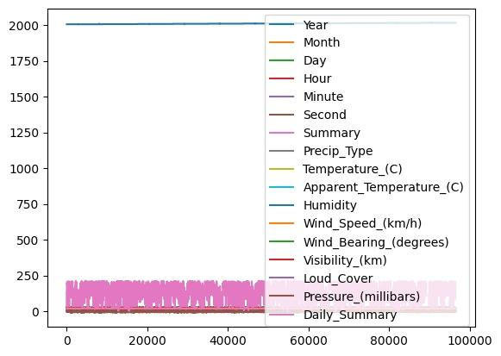
Result
Axes
Fig.Weather prediction

Slide 14
References
https://www.tensorflow.org/
https://numpy.org/
https://scikit-learn.org/stable/
https://keras.io/
https://matplotlib.org/
Data set link
https://www.kaggle.com/datasets/muthuj7/weather-dataset/download?datasetVersionNumber=1

Slide 15
Conclusion
In conclusion, utilizing Generative Adversarial Networks (GANs) for weather pattern prediction shows promising potential. By leveraging the power of GANs,researches and meteorological can generate Realistic weather data, facilitating improve Forecasting accuracy.

Slide 16
Thank you

